Slide 1
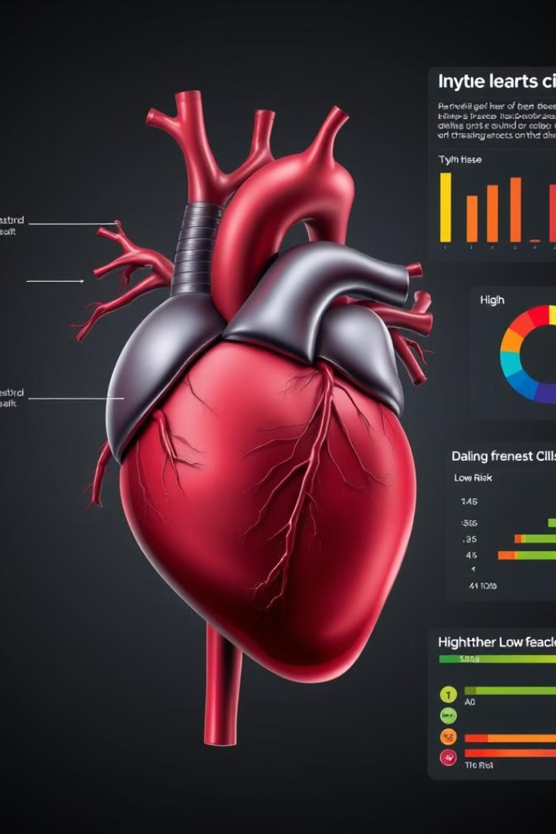
Heart Disease Prediction using Machine Learning
This presentation explores the application of machine learning to predict heart disease, a leading cause of death globally.
DEVAANSH DUBEY - E23CSEU0655
KRITIKA - E23CSEU0642

Slide 2
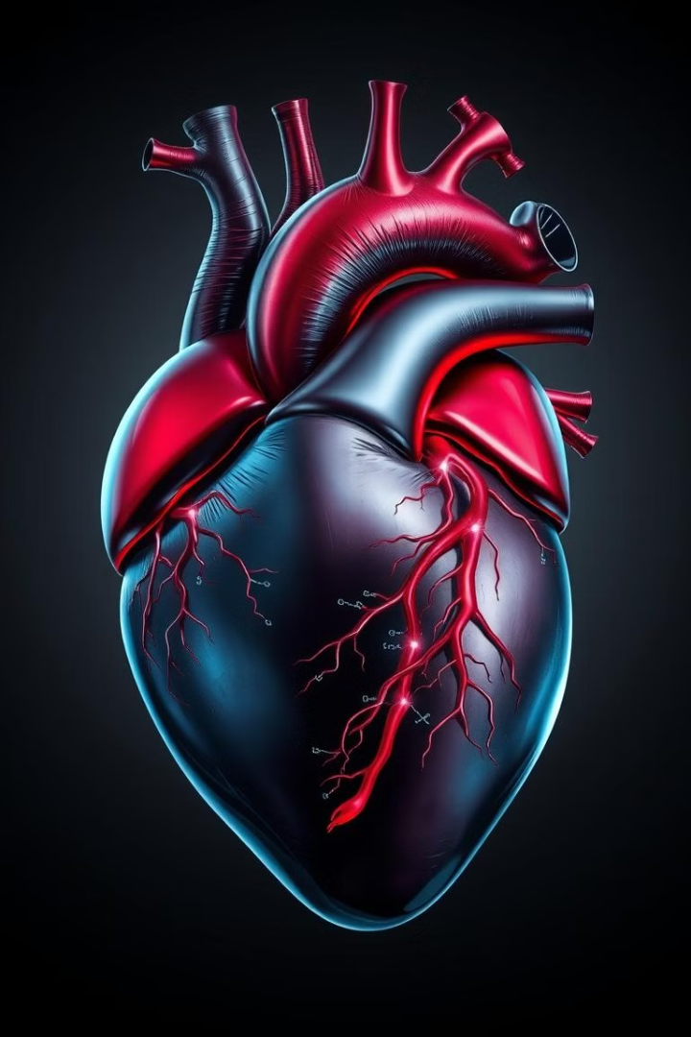
Introduction to Heart Disease
1
Cardiovascular Disease
2
Risk Factors
Heart disease encompasses a range of conditions affecting the heart and blood vessels, impacting millions worldwide.
Factors like high blood pressure, cholesterol, and smoking increase the risk of developing heart disease.
3
Symptoms
4
Early Detection
Chest pain, shortness of breath, and fatigue are common symptoms, but they can vary depending on the type of heart disease.
Early detection through screenings and lifestyle modifications is crucial for managing and preventing heart disease.

Slide 3

Data Collection and Preprocessing
Data Sources
1
Data can be collected from various sources, including electronic health records, clinical trials, and public health surveys.
2
Data Cleaning
Preprocessing involves cleaning the data, addressing missing values, and transforming variables into suitable formats.
Data Transformation
3
Data is often transformed to normalize values, handle categorical variables, and improve model performance.

Slide 4

Feature Selection and Engineering
Feature Selection
Feature Engineering
Identify relevant features from the dataset that are most predictive of heart disease.
Create new features by combining existing ones, potentially improving model accuracy.
Feature Importance
Determine the relative importance of each feature, providing insights into key predictors.

Slide 5
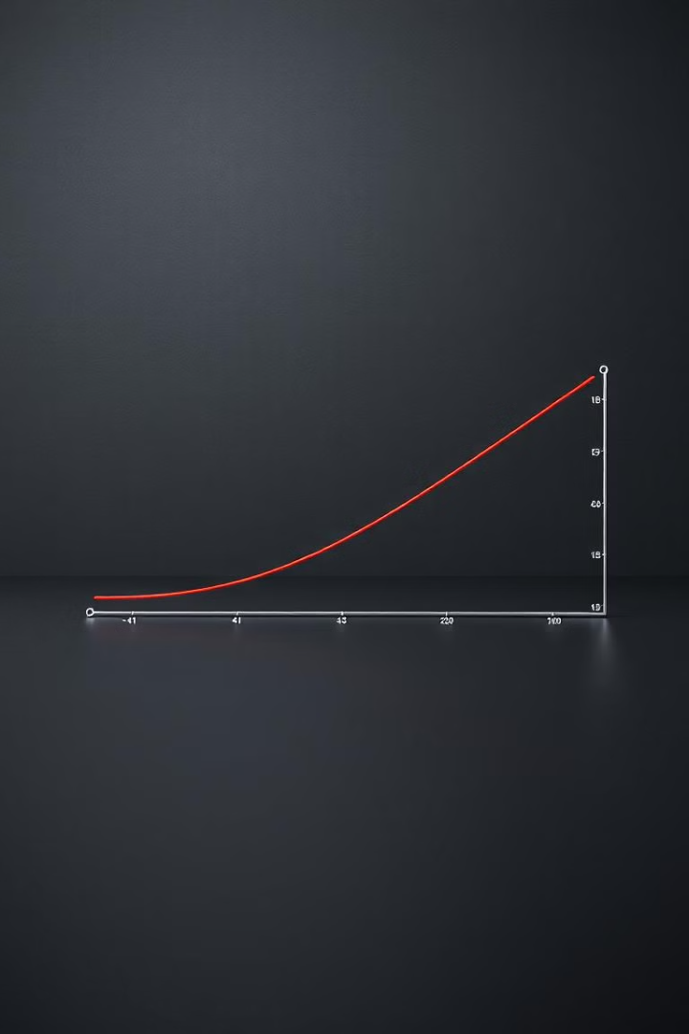



Implementing Logistic Regression Model
Linear Model
Uses a linear equation to predict the probability of an event.
Sigmoid Function
Transforms the linear output into a probability between 0 and 1.
Classification
Predicts whether an individual has heart disease based on the probability.

Slide 6
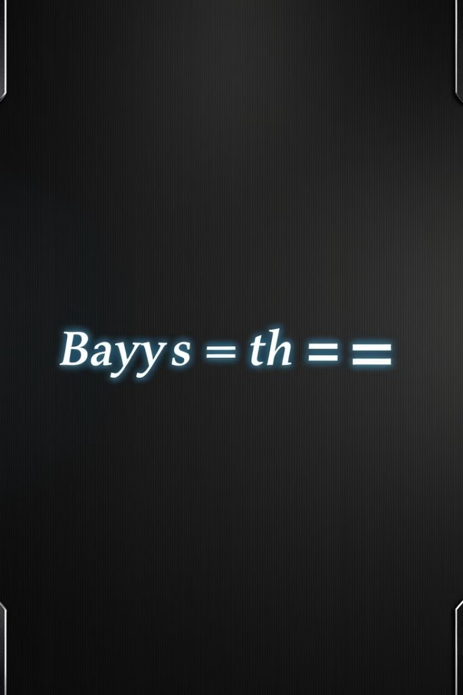
Implementing Naive Bayes Model
Based on Bayes' theorem, it calculates the probability of an event based on prior knowledge.
Assumes independence between features, simplifying the calculation of conditional probabilities.
Suitable for high-dimensional datasets and efficient in handling missing data.

Slide 7
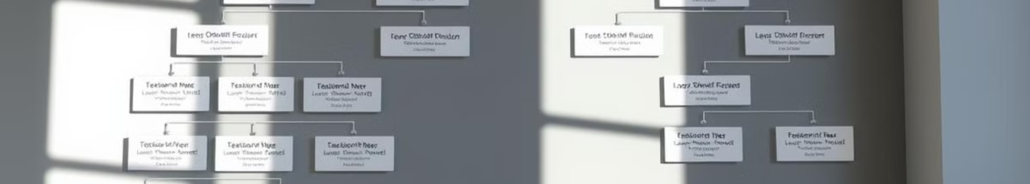
Decision Tree: Structure and Decision-Making
Root Node
Leaf Nodes
Starts the decision process with the most important feature.
Final predictions or classifications.
1
2
3
Internal Nodes
Represent features used to split the data.

Slide 8

Support Vector Machines (SVM): Fundamentals
Objective
Find the optimal hyperplane that maximizes the margin between classes.
Support Vectors
Data points closest to the hyperplane that determine the margin.
Kernel Trick
Transforms data into a higher-dimensional space to find linear separation.

Slide 9
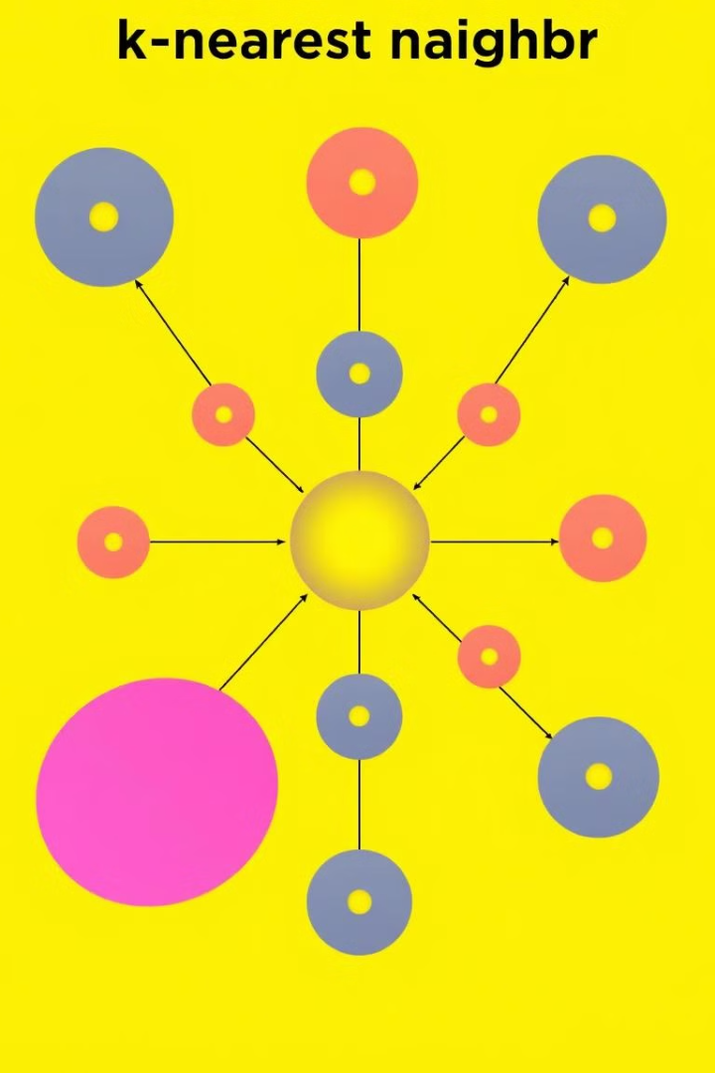
Principle of KNN
1
Proximity-Based Learning
2
Value of k
The number of nearest neighbors (k) is a key parameter that affects the algorithm's performance.
KNN makes predictions based on the proximity of new data to the training samples.
3
Majority Vote
For classification, the algorithm assigns the label of the majority of the k nearest neighbors.

Slide 10




Implementing Random Forest Model
Ensemble Learning
Bagging and Random Subspace
Majority Vote
Random forest combines multiple decision trees to make predictions, reducing the risk of overfitting.
Predictions from individual trees are aggregated through a majority vote, leading to more robust predictions.
The algorithm uses bootstrapping and random feature selection to create diverse trees.

Slide 11
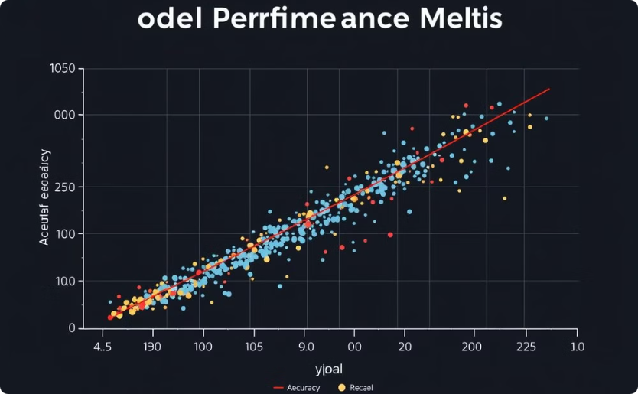
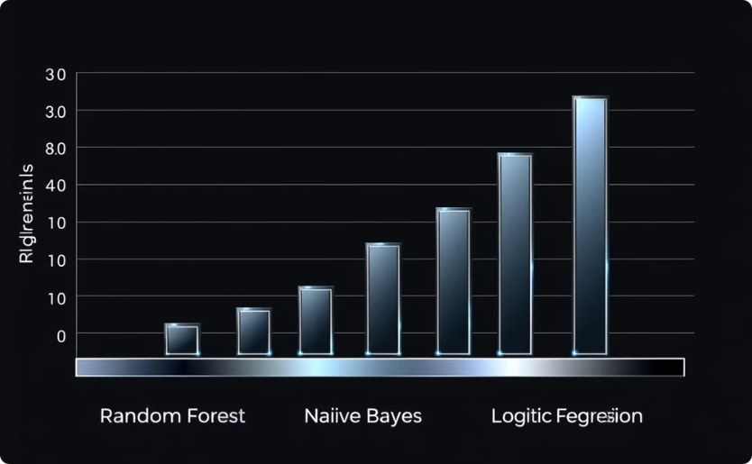
Model Comparison and Evaluation
Performance Metrics
Model Comparison
Assess model accuracy, precision, recall, and other metrics to evaluate its performance.
Compare the performance of different models to identify the best predictor for heart disease.

Slide 12
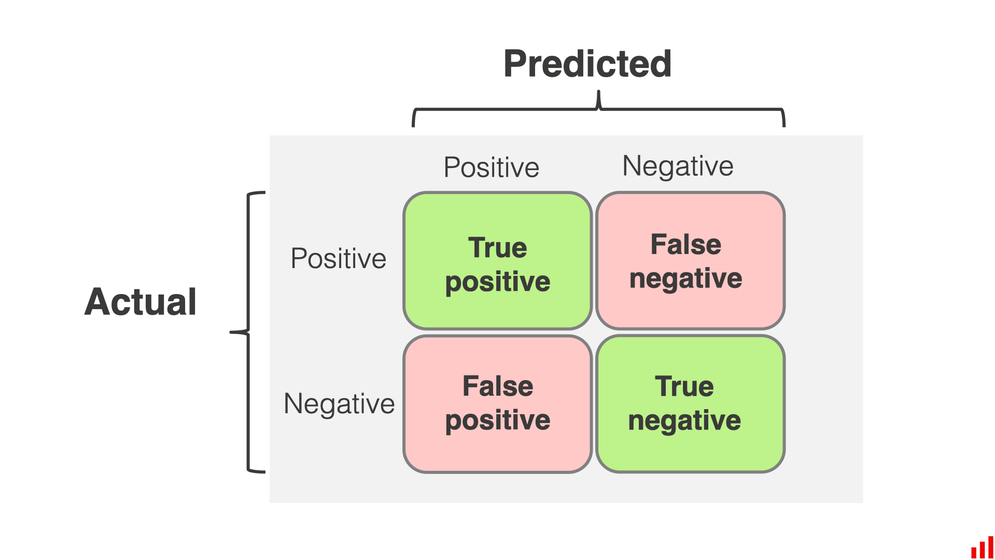




Comparison Metrics: F1-Score, Accuracy, Specificity, Precision, Recall
Accuracy
Precision
Percentage of correct predictions.
Percentage of positive predictions that were correct.
Recall
F1-Score
Percentage of actual positive cases that were correctly predicted.
Harmonic mean of precision and recall.

